Slide 1
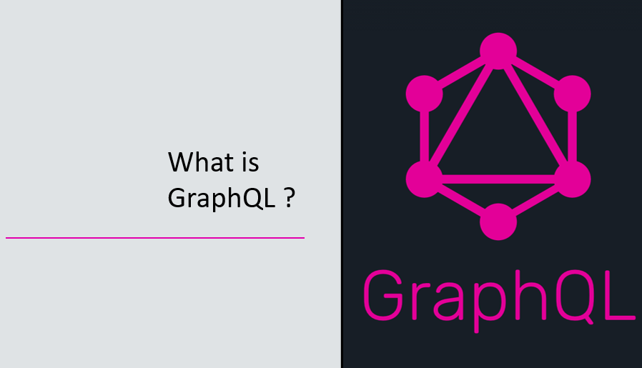

Slide 2
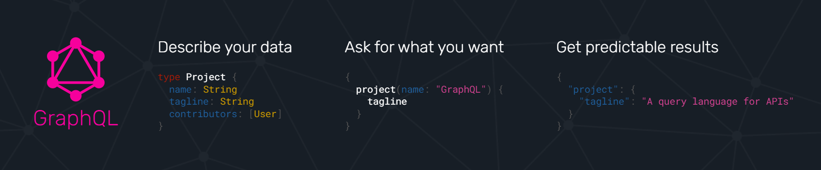
GraphQL
GraphQL is a query language for APIs and a runtime for fulfilling those queries with your existing data. GraphQL provides a complete and understandable description of the data in your API, gives clients the power to ask for exactly what they need and nothing more, makes it easier to evolve APIs over time, and enables powerful developer tools

Slide 3
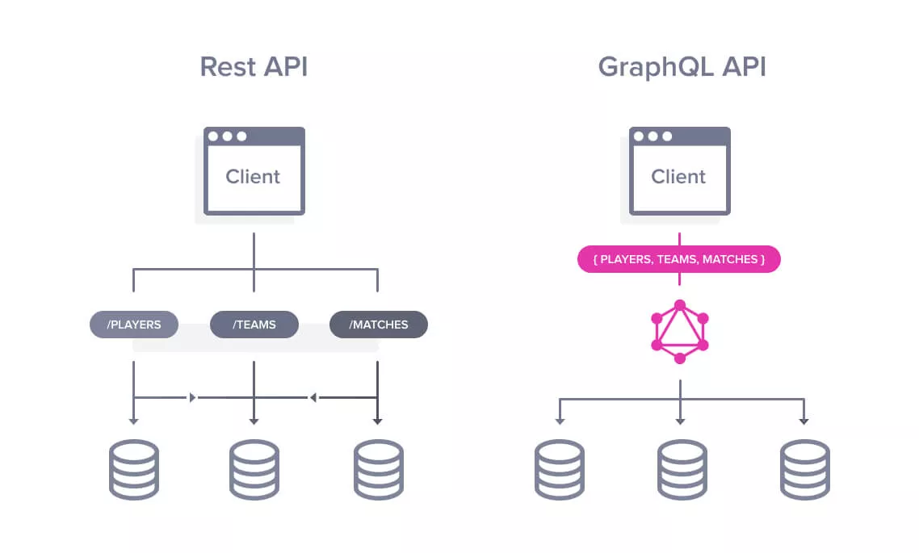
Rest API vs GraphQL API

Slide 4
Rest API vs GraphQL API
• Fetching complex data using REST was a little bit tough as more than one request was needed to create, But with Graphql entire data can be fetched in a single request only.
• GraphQL minimizes the amount of data that needs to be transferred over the network and thus improves application performance.
• Different frameworks and platforms makes it difficult to build and maintain one API that would fit all the requirements. With GraphQL each client can precisely access data.

Slide 5
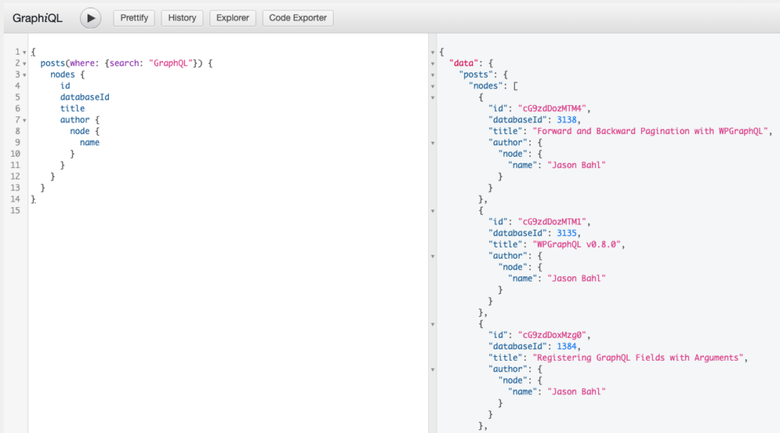
GraphQL Query
Queries fetch data – like a GET in rest

Slide 6
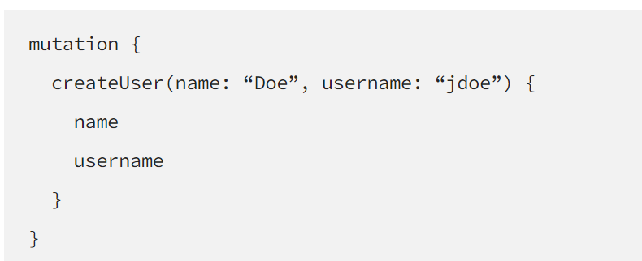
GraphQL Mutation
mutations are used to :
Create new data
Update existing data
Delete existing data

Slide 7
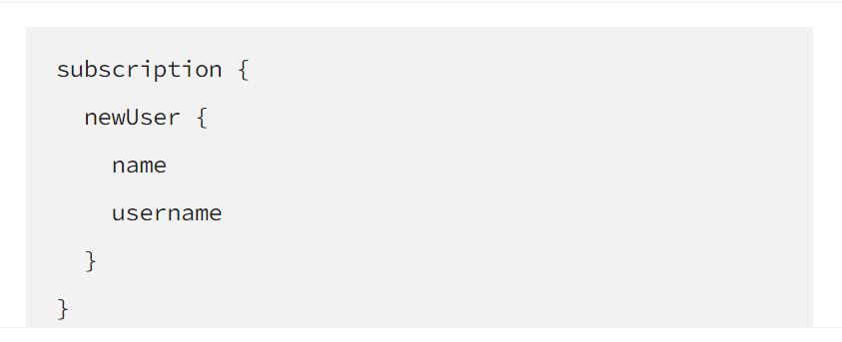
GraphQL Subscription
Subscriptions are a way to create and maintain real time connection to the server. This enables the client to get immediate information about related events. Basically, a client subscribes to an event in the server, and whenever that event is called, the server will send the corresponding data to the client.

Slide 8
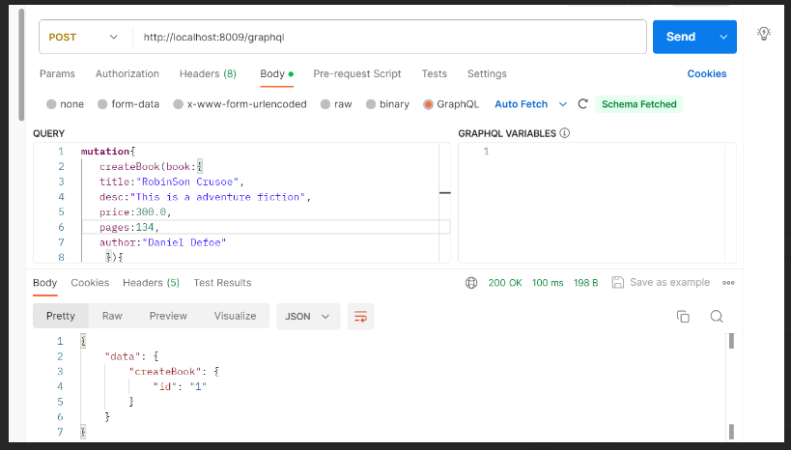
GraphQL API
GraphQL query for POST

Slide 9
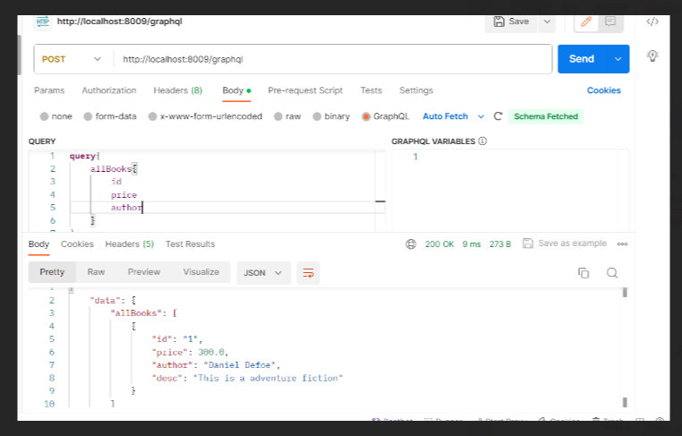
GraphQL API
GraphQL query for find all

Slide 10
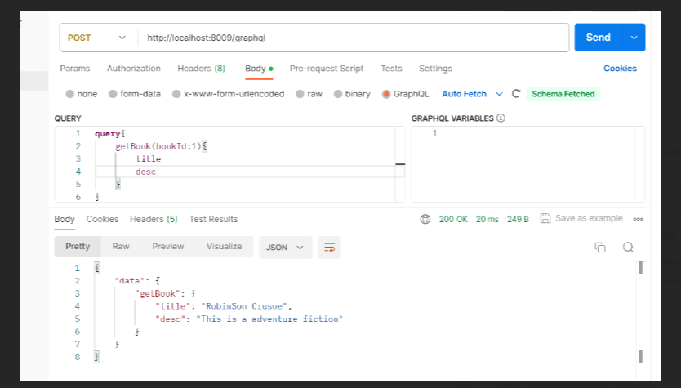
GraphQL API
GraphQL query for find By Id

